Slide 1
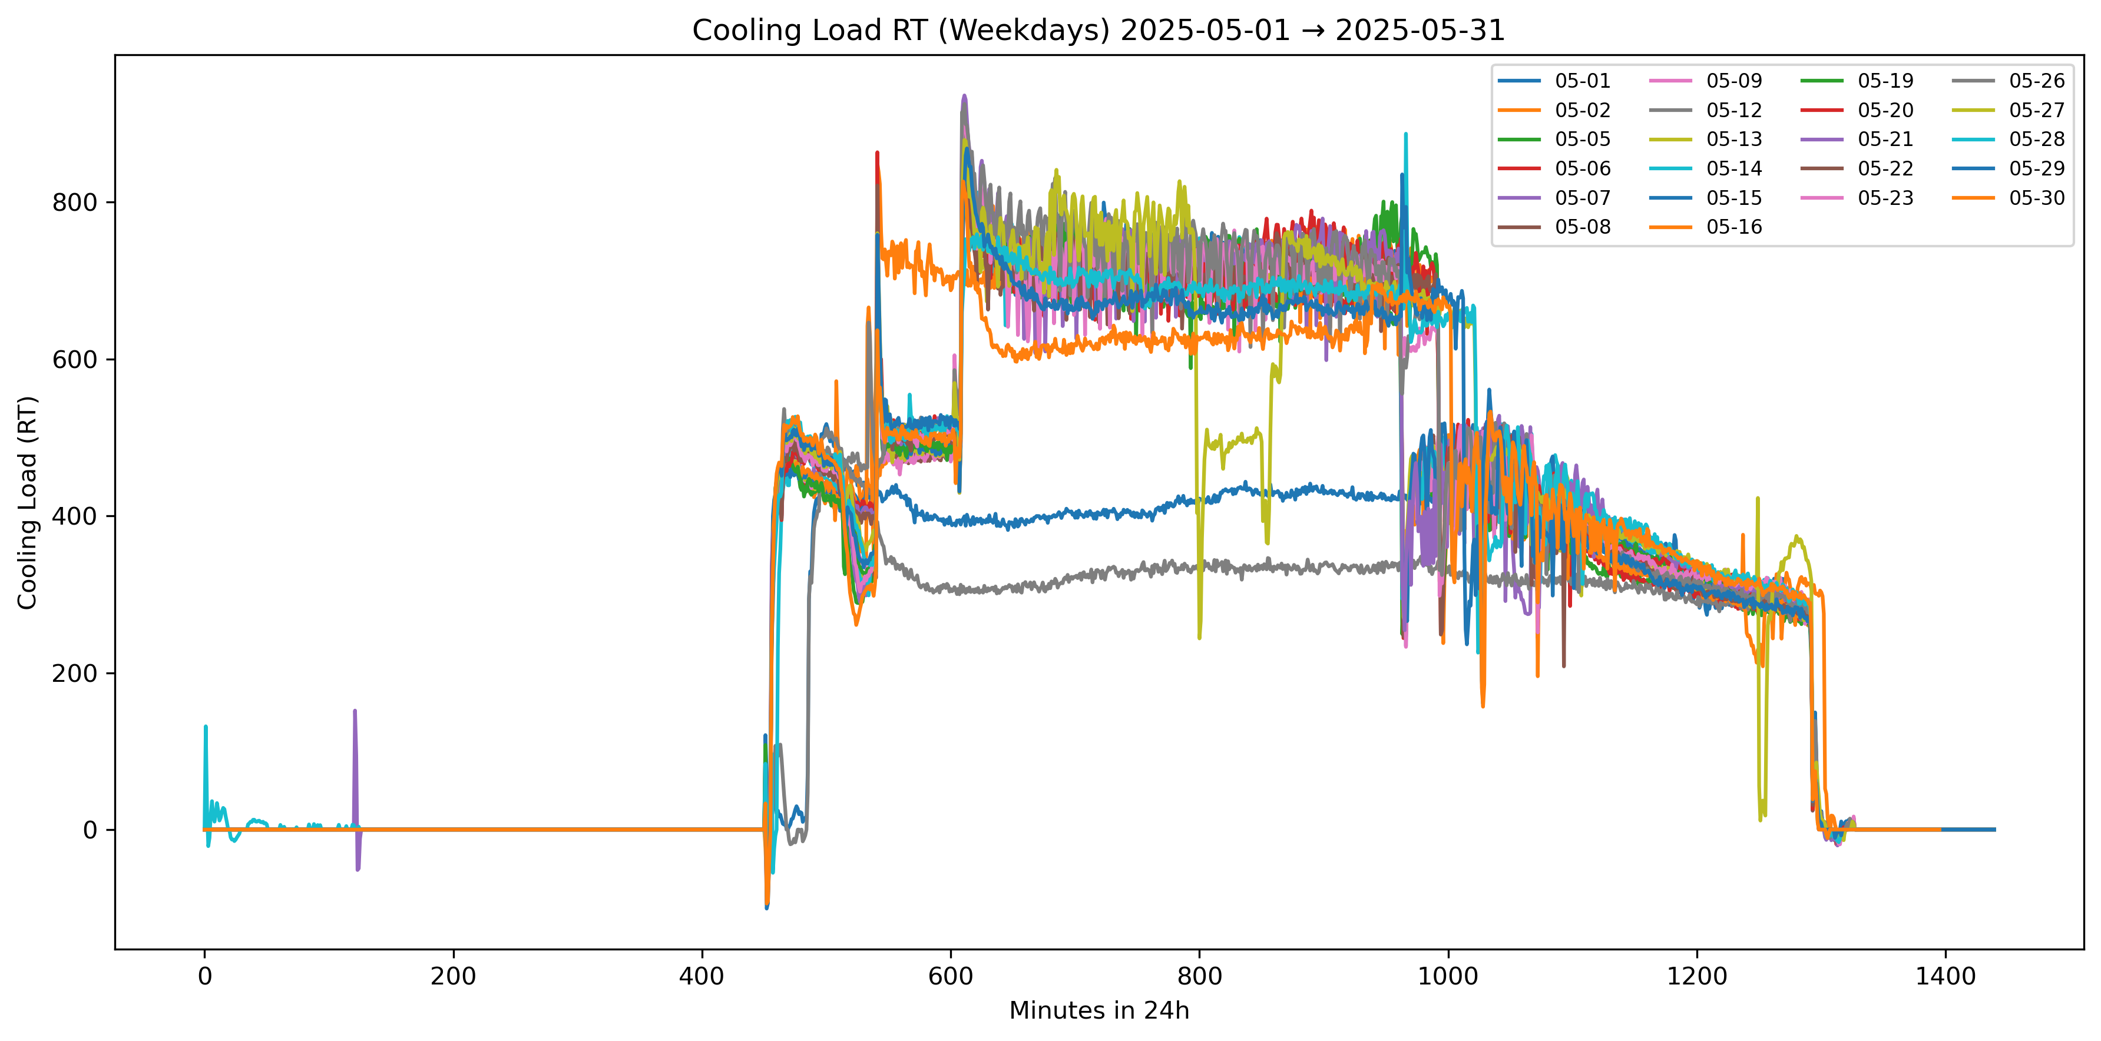
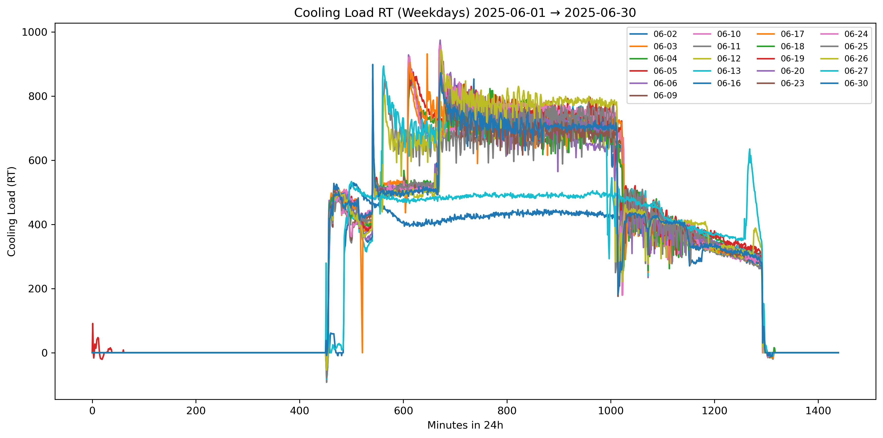
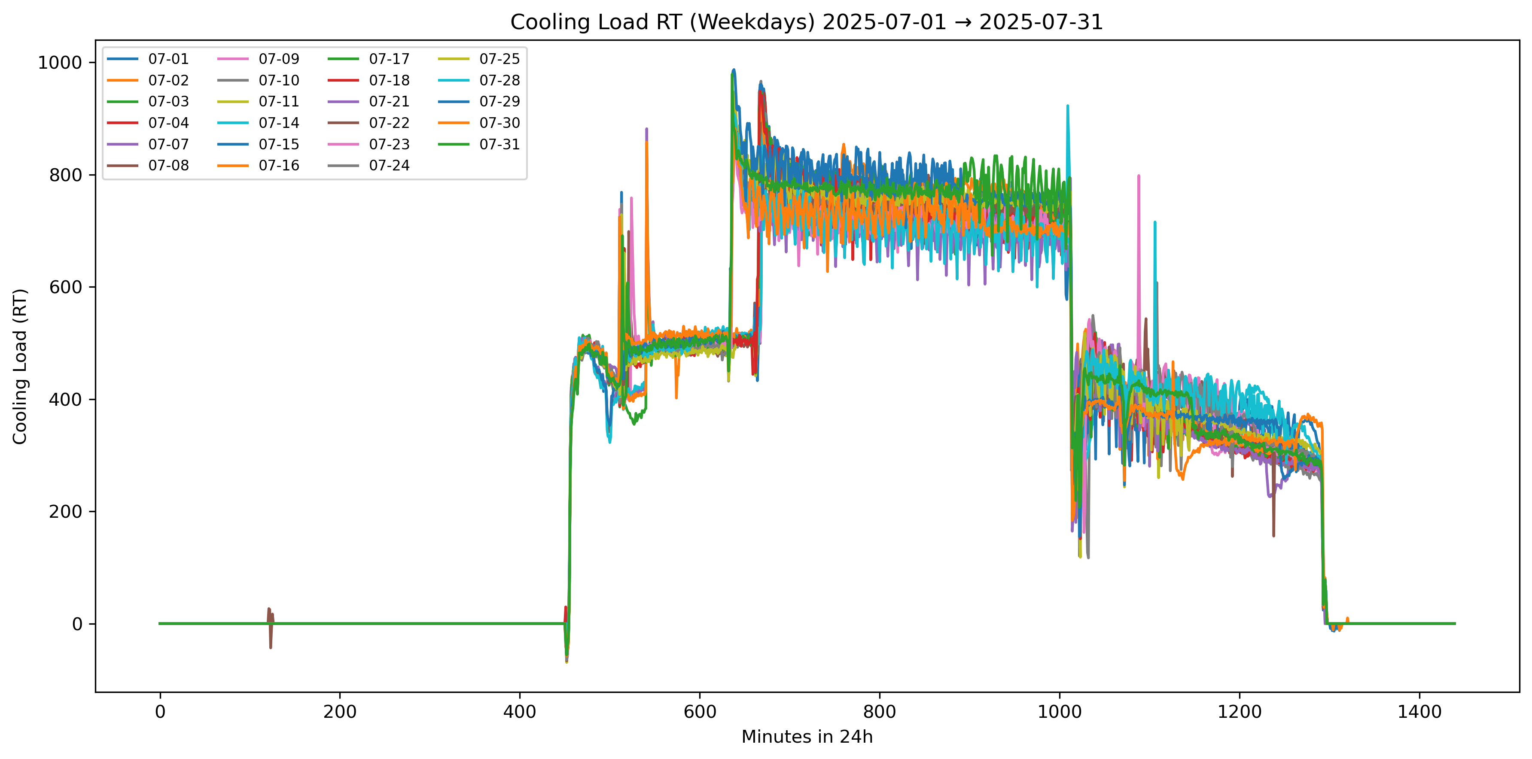
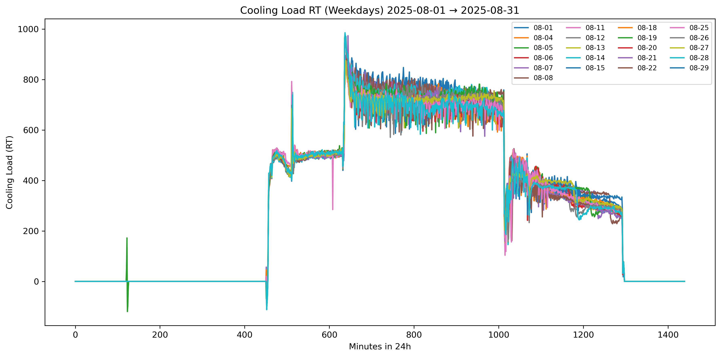
df["TOTAL_COOLING_RT"] = (df["EMML_MOD_PWR"]+df["EMBS_MOD_PWR"]) / 3.517
8am-830am operate till around 930pm-10pm

Slide 2
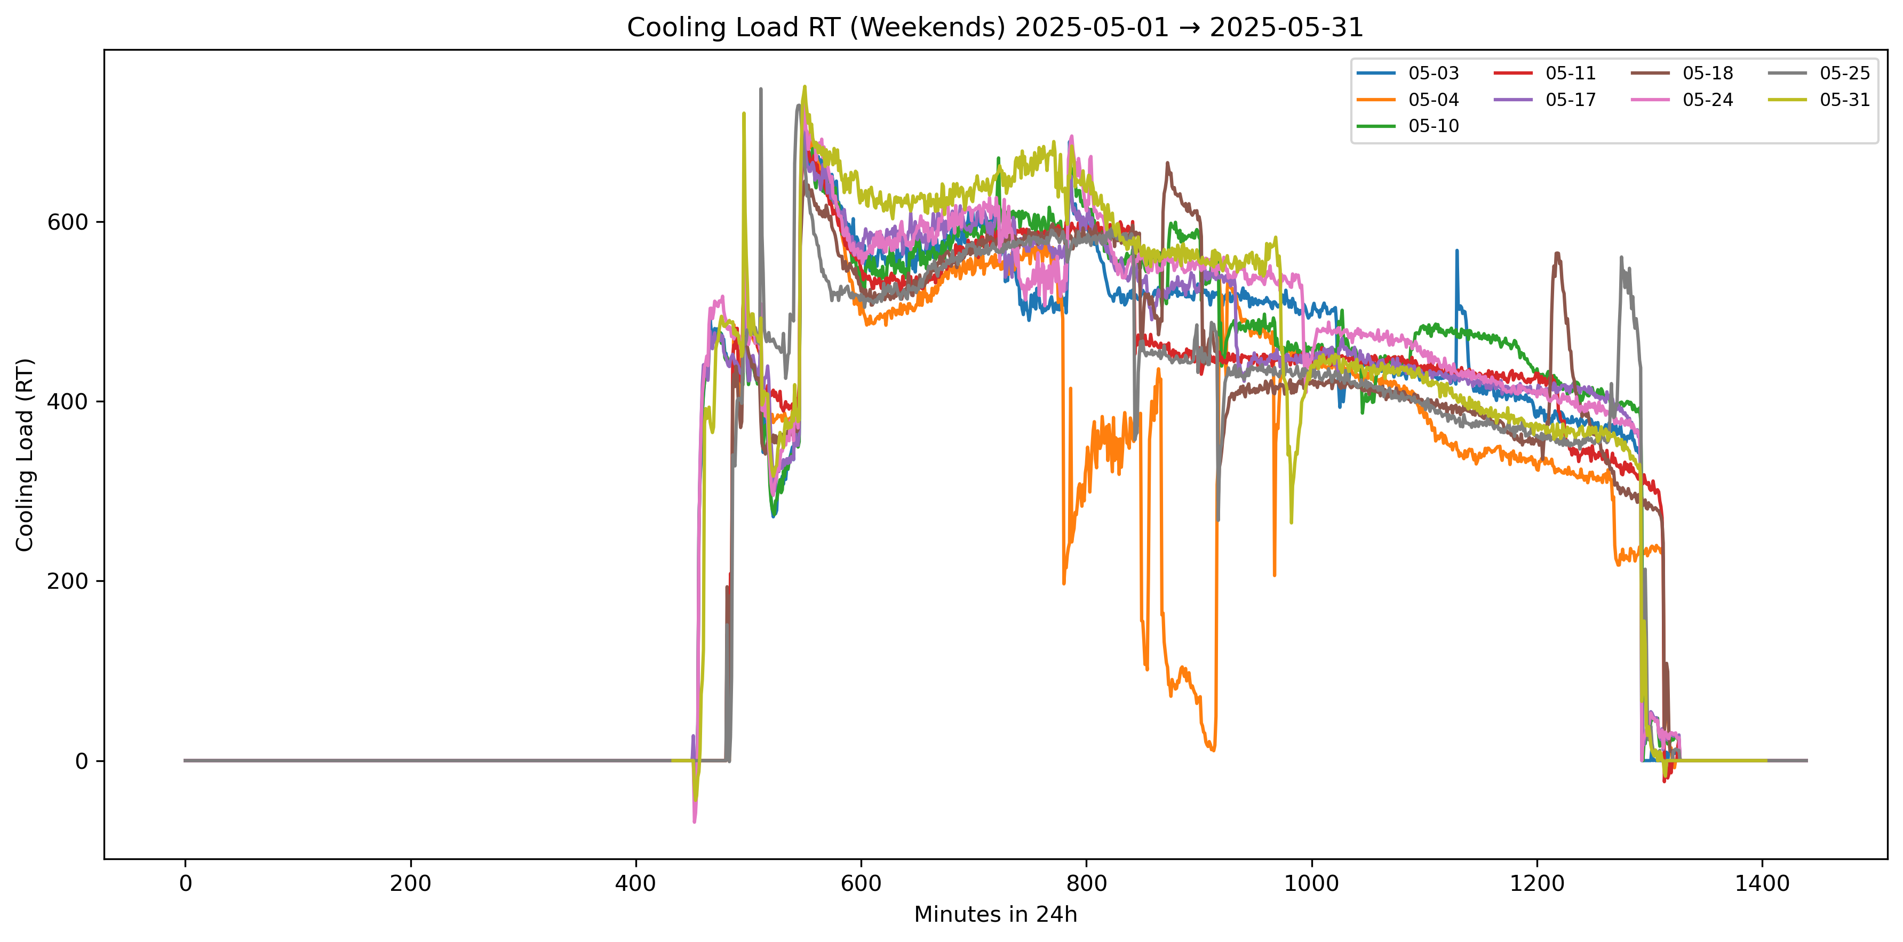
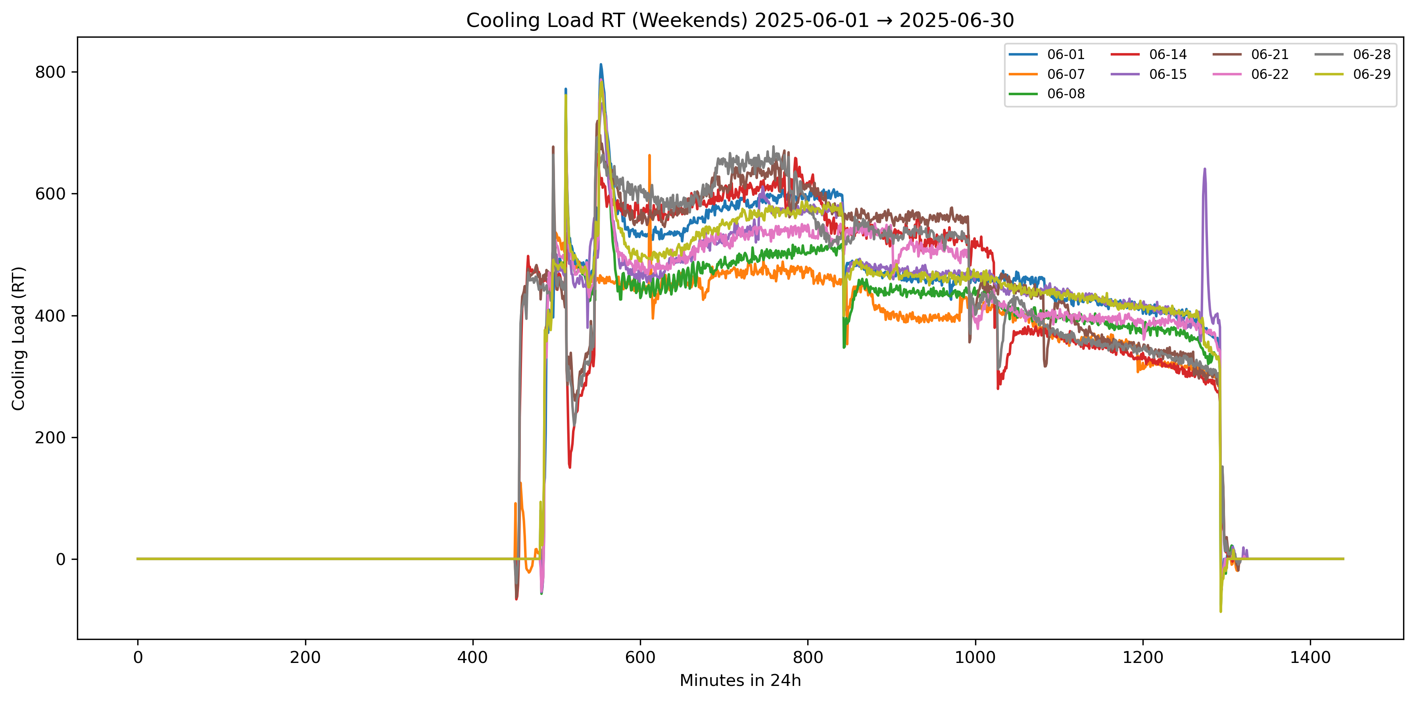
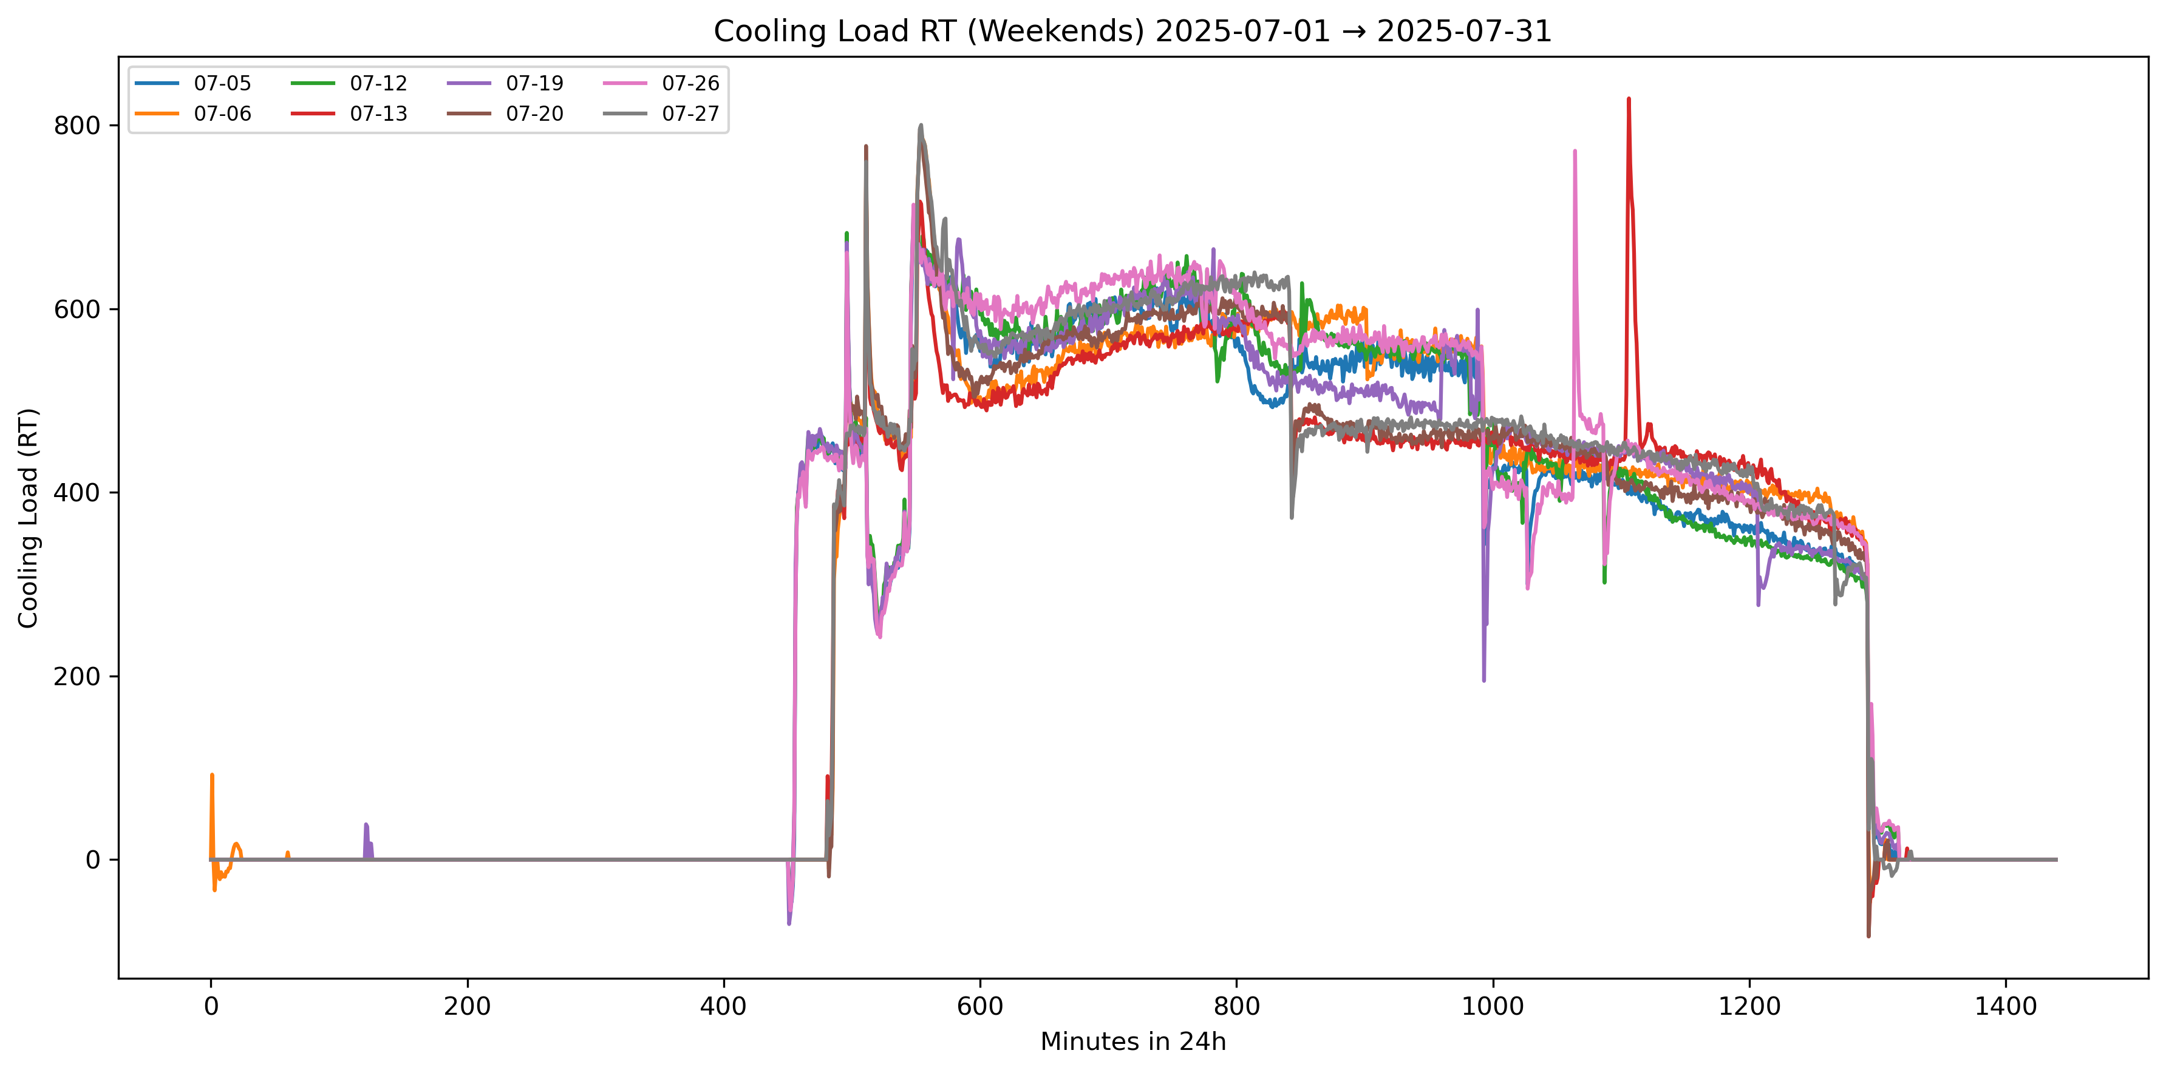
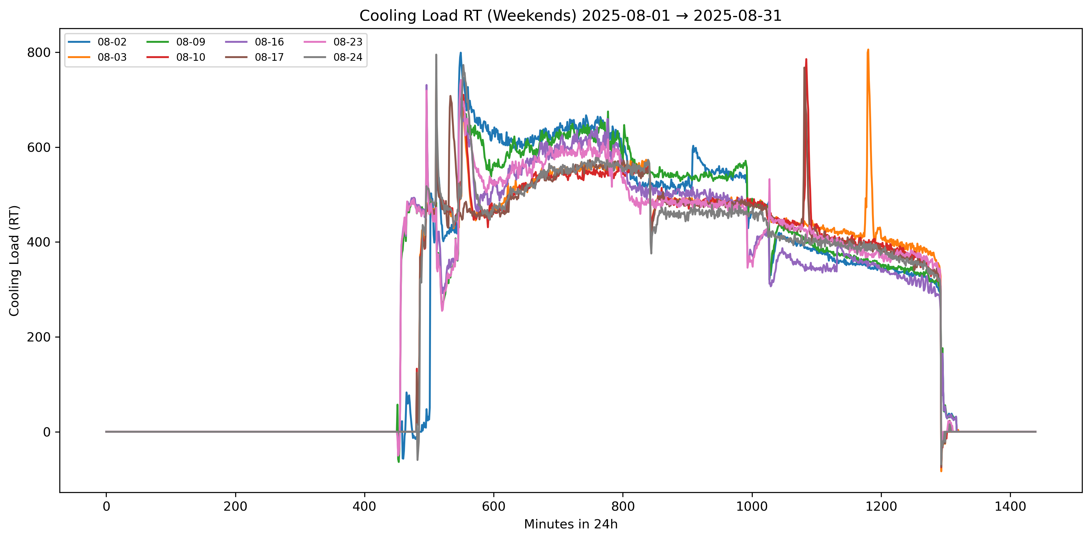
df["TOTAL_COOLING_RT"] = (df["EMML_MOD_PWR"]+df["EMBS_MOD_PWR"]) / 3.517
8am-830am operate till around 930pm-10pm

Slide 3
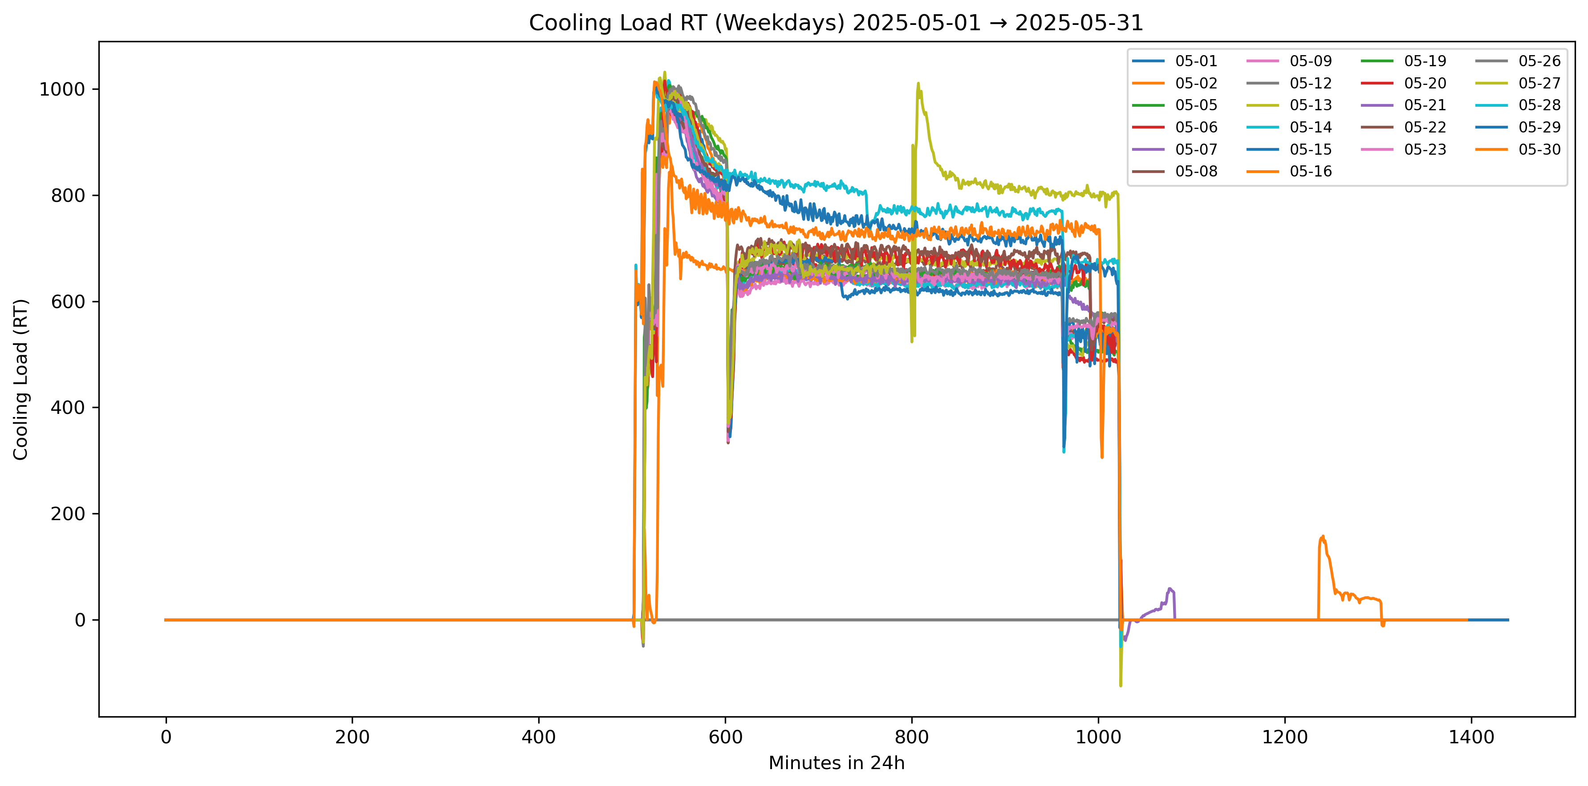
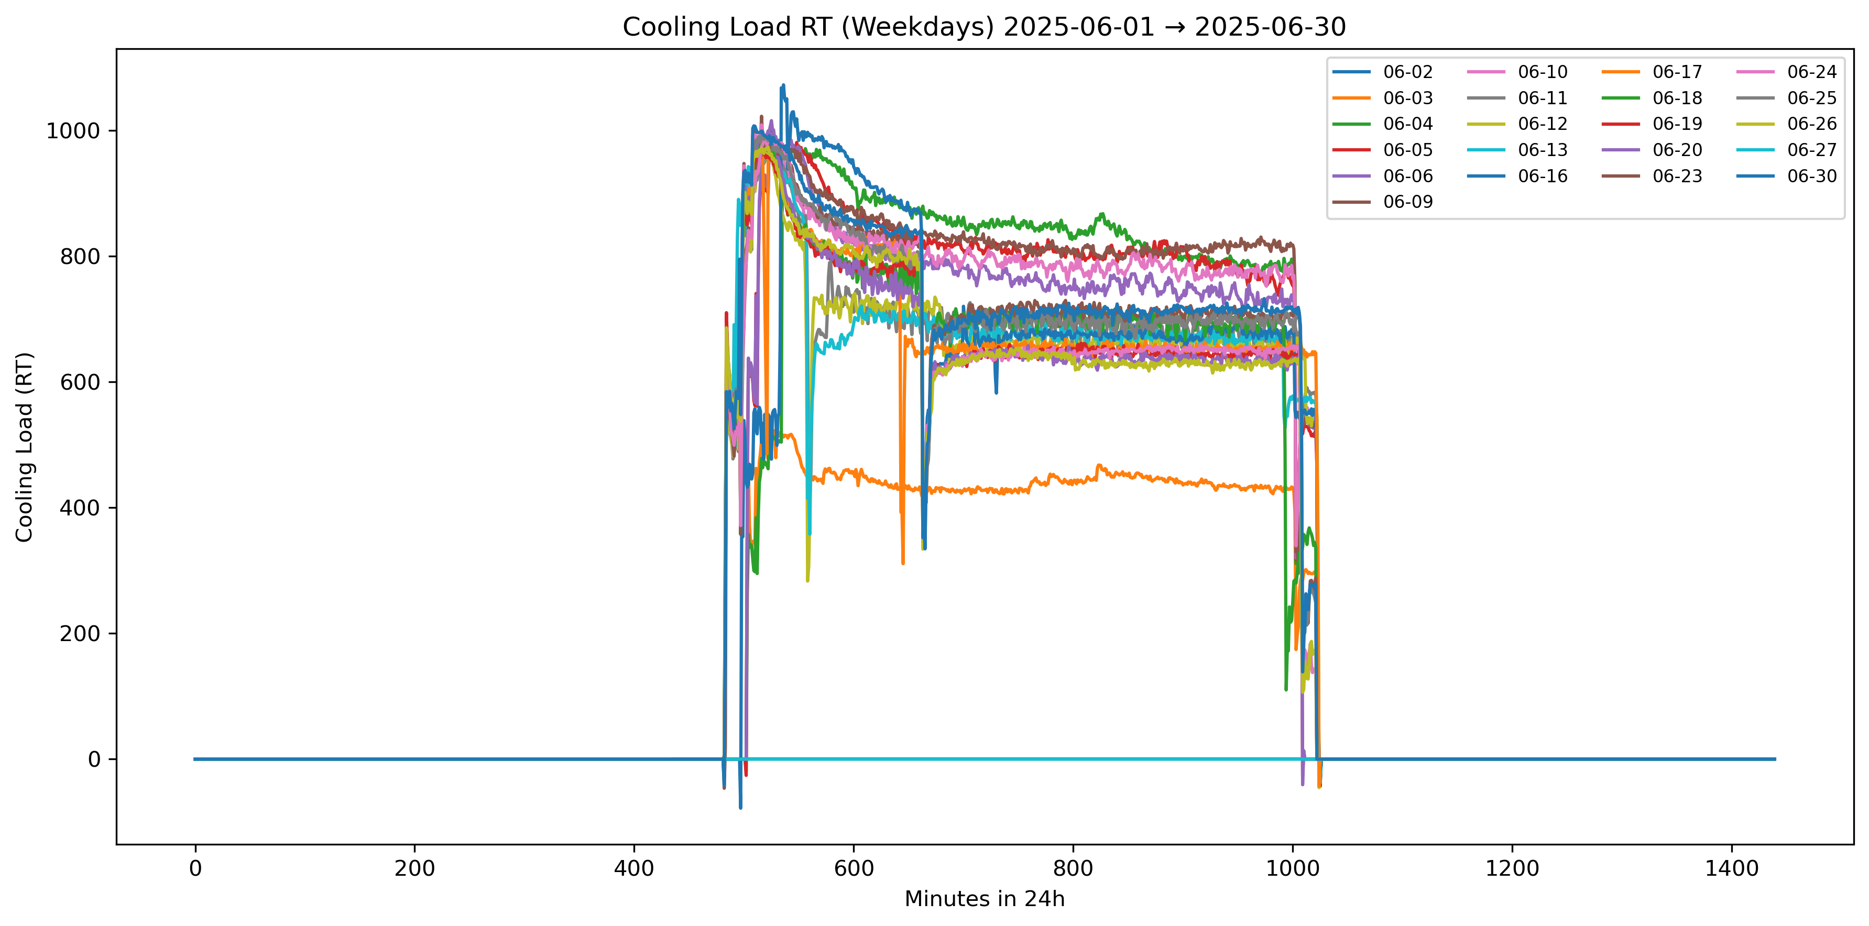
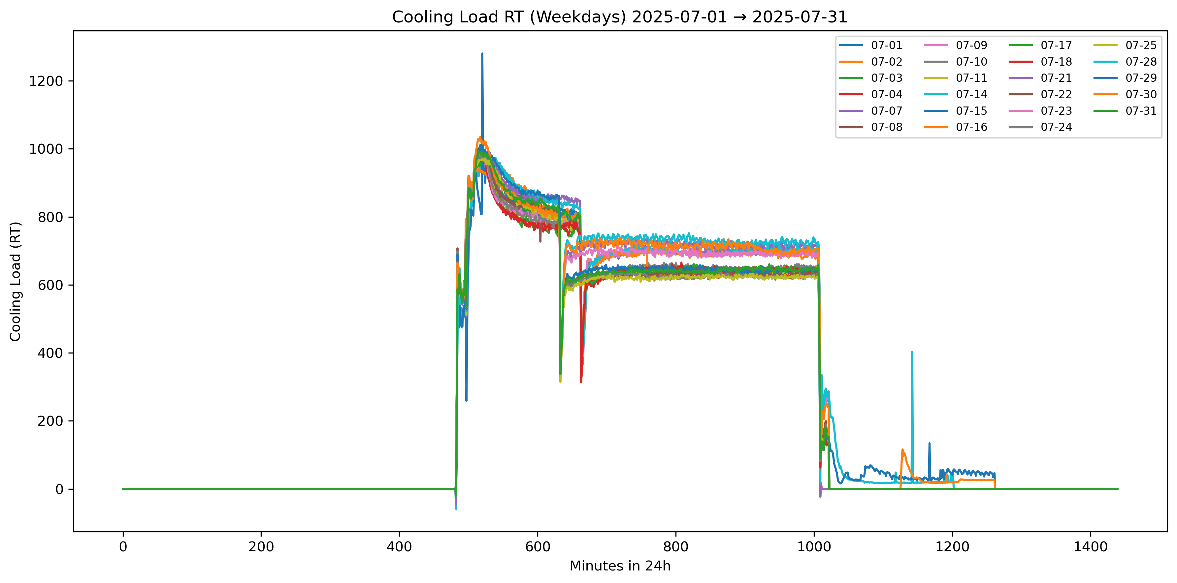
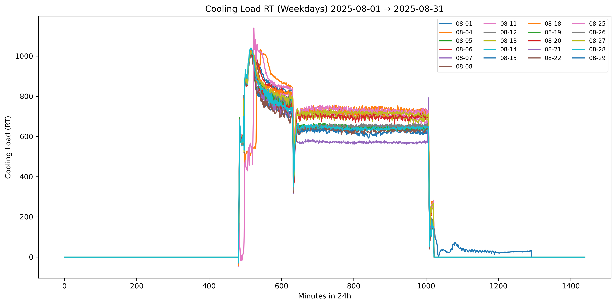
df["TOTAL_COOLING_RT"] = (df["EMTA_MOD_PWR"]+df["EMTB_MOD_PWR"]) / 3.517
Cuts in 1030am Stop 4-5pm

Slide 4
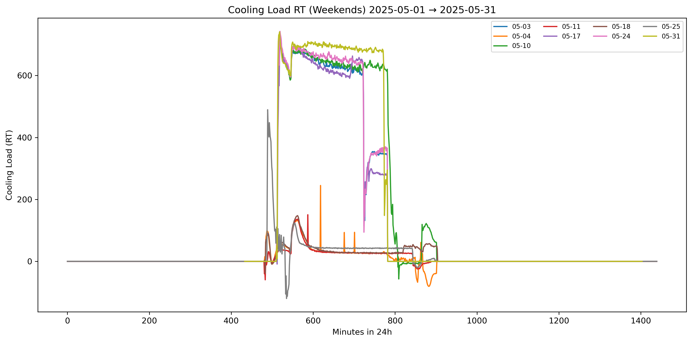
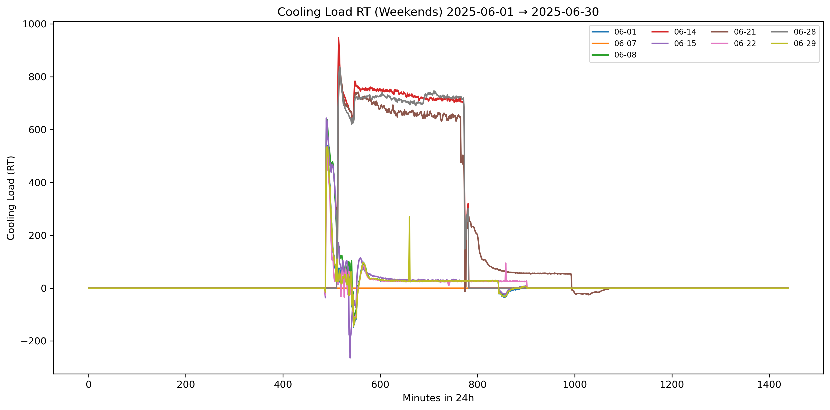
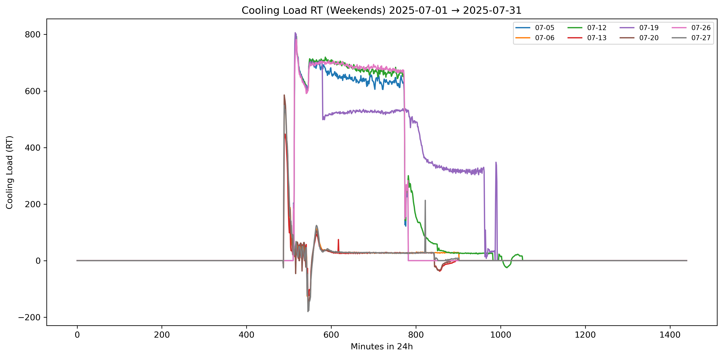
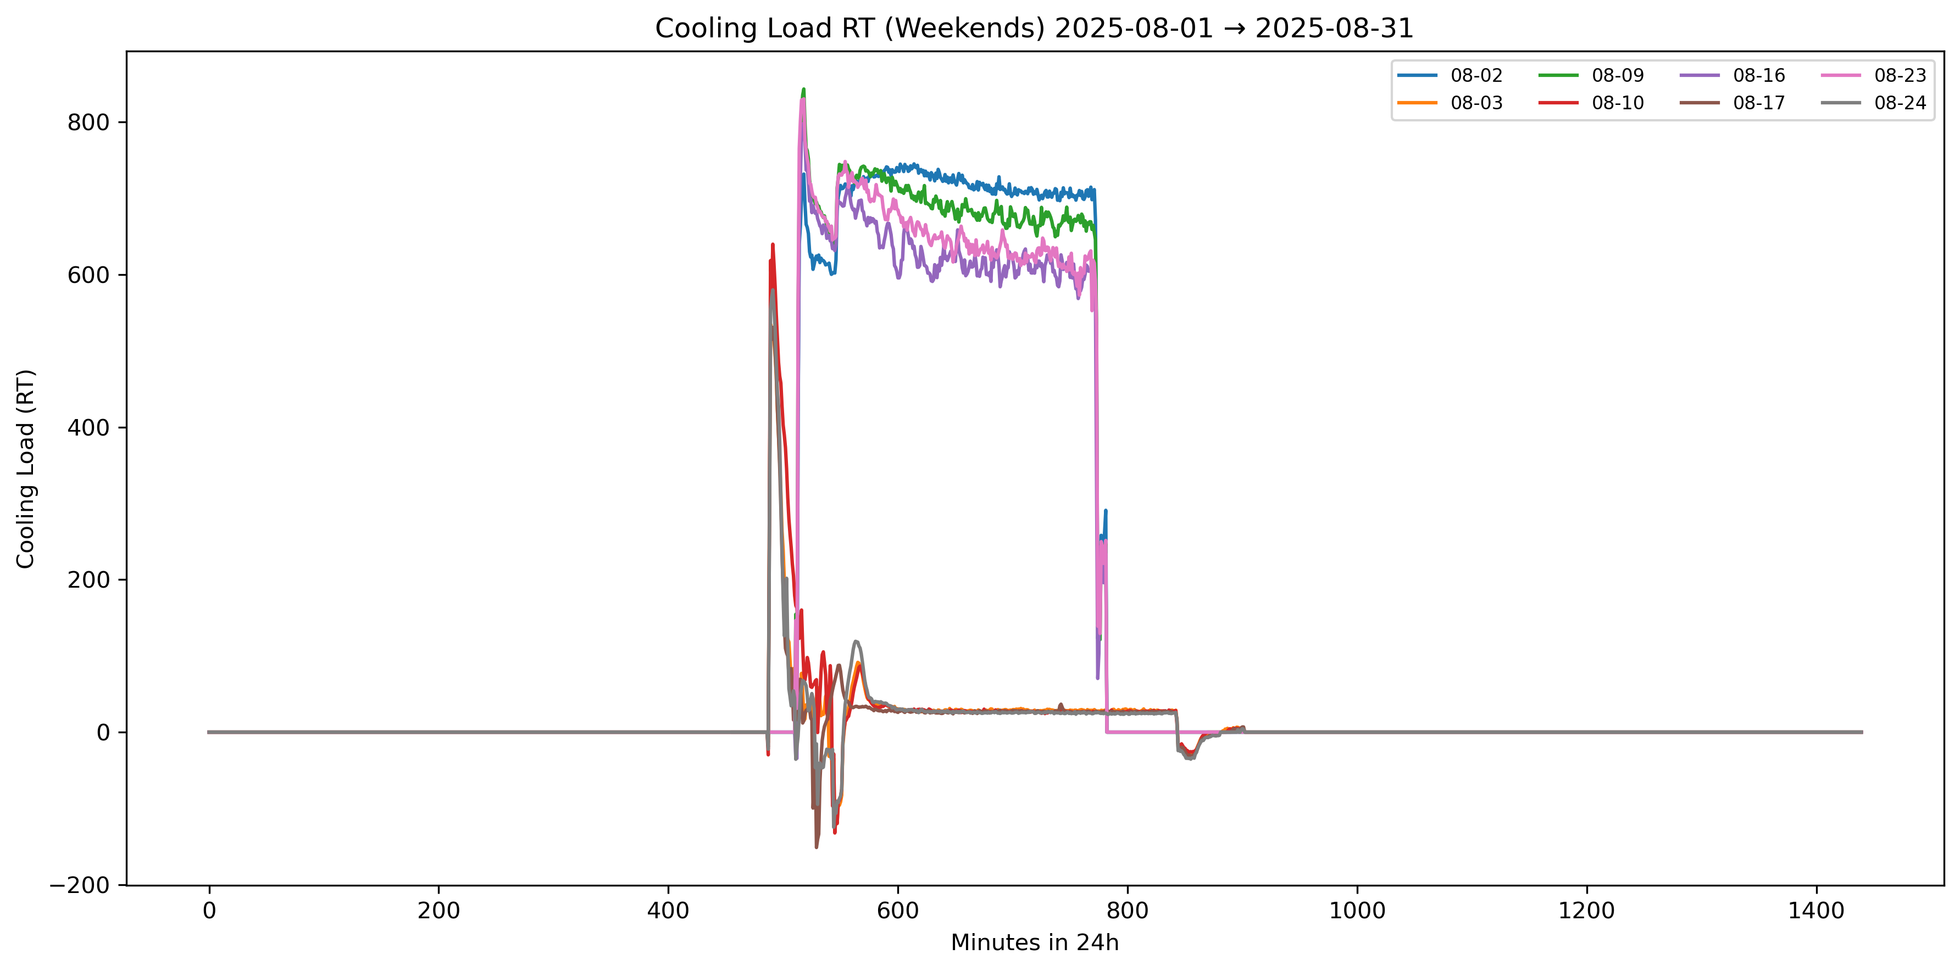
df["TOTAL_COOLING_RT"] = (df["EMTA_MOD_PWR"]+df["EMTB_MOD_PWR"]) / 3.517
Sundays value 0

